Slide 1

Introduction
The aim of this presentation is to tell you about recycling and how our school has increased recycling and benefitted by "Friendly Garbage".

Slide 2

Weighing routine
The students on The Green Schools committee collect refuse and recyclables every day and put it aside for us to weigh.The four of us on the recycling committee meet up at 3.30 on Tuesday. We weigh the refuse and the recycling material. The figures are recorded on Stuart's iPad and we go to Room 12 to compile our statistics.

Slide 3
Compiling the statistics
In Room 12 we add our weights and get a weekly average for refuse and recycling. We have been keeping track for 3 week periods so the new figures are included in the 3 week bar chart.

Slide 4
November
In November recycling was 37% of the weighed total.
Refuse was 63%.
Our aim at the end of December was to reduce refuse by 5%.
Green = Recycling
Blue = waste

Slide 5
December
In December recycling was at 47%
Refuse had reduced to 53%.
Our aim in January was to reduce refuse by 10%.
Green = Recycling
Blue = waste

Slide 6
January
In January recycling was at 59%.
Refuse was at 41%.
Our aim for February was to reduce refuse by 15%
Green = Recycling
Blue = waste

Slide 7
February
In February recycling is at 80%.
Refuse is at 20%.
Our aim in March is to reduce refuse by 5%.
Green = Recycling
Blue = waste

Slide 8
March
In March recycling is at 83%
Waste is at 17%
Our aim in March is to reduce refuse by 5%
Green = Recycling
Blue = waste

Slide 9
April
In April recycling is at 89%
Waste is at 11%
Our aim in May is to reduce refuse by 5%
Green = Recycling
Blue = waste

Slide 10
May
In April recycling is at 90%
Waste is at 10%
Our aim in October is to reduce refuse by 5%
Green = Recycling
Blue = waste

Slide 11
August
In August recycling was at 92%
In August waste was at 8%
Our aim was to reduce refuse by whatever possible.

Slide 12
September
In September recycling was at 94%.
In September waste was at 6%.
Our aim was to reduce refuse by whatever possible.

Slide 13
October
In October recycling was at 95%.
In October waste was at 5%.
Our aim was to reduce refuse by whatever possible.

Slide 14
November
In October recycling was still at 95%.
In October waste was still at 5%.
Our aim was to reduce refuse by whatever possible.

Slide 15
December
In October recycling was at 96%.
In October waste was at 4%.
Our aim was to reduce refuse by whatever possible.

Slide 16
January
In October recycling was still at 96%.
In October waste was still at 4%.
Our aim was to reduce refuse by whatever possible.

Slide 17
February
In October recycling was at 97%.
In October waste was at 3%.
Our aim was to reduce refuse by whatever possible.

Slide 18
How we have improved from last year

Slide 19
Plans for the future
Reduce Waste to 4%
Get recycling to 96%
Put up more posters about raising awareness about the importance of recycling
Make this project effective outside of school.
Introduce this project to more secondary schools.
Make a book about each country.

Slide 20

Composting
We have started composting in the staff room in the school, we will then hopefully bring it into all the home ec rooms in the school and also the kitchen. We are then going to concentrate on bringing the compost and recycling project into other schools by putting it on our website and raising awareness outside of school.

Slide 21
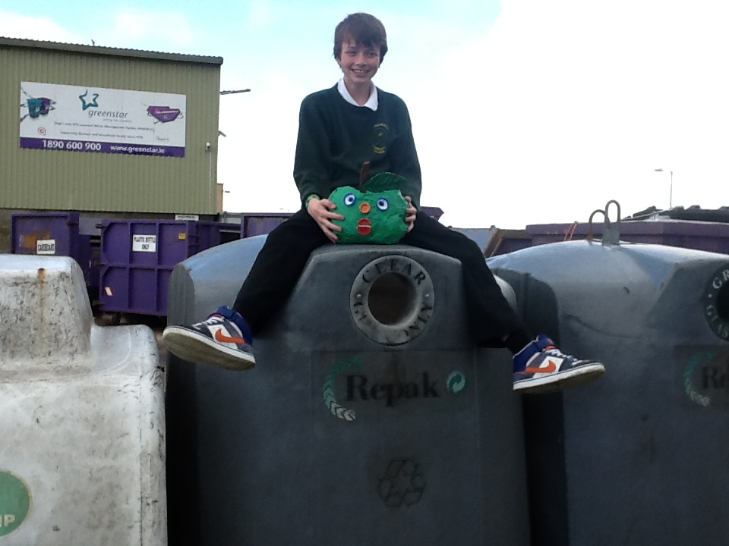
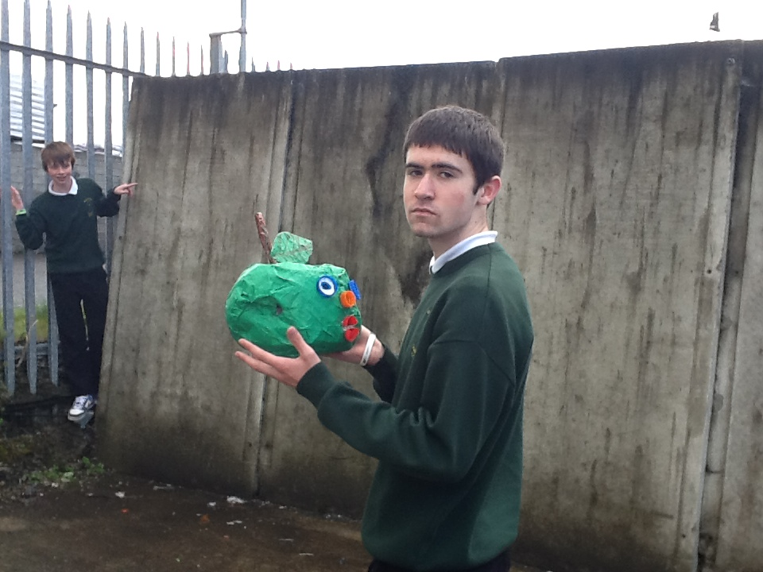
Our trip to the recycling plant

Slide 22
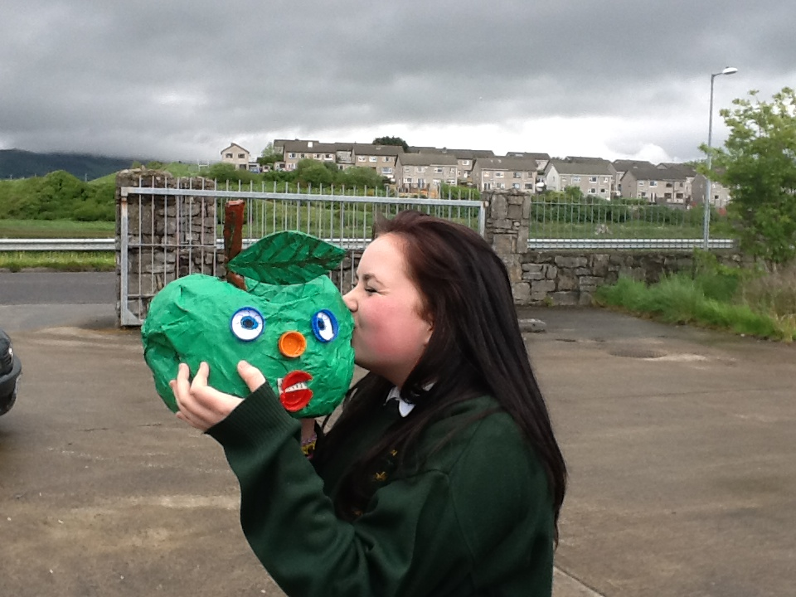
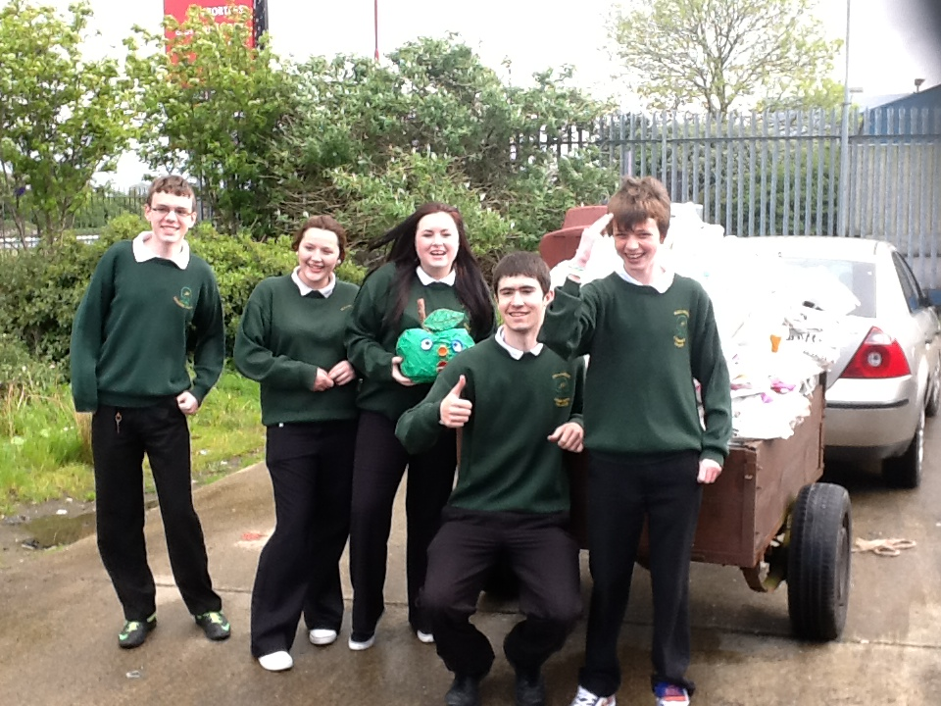
Our trip to the recycling plant

Slide 23
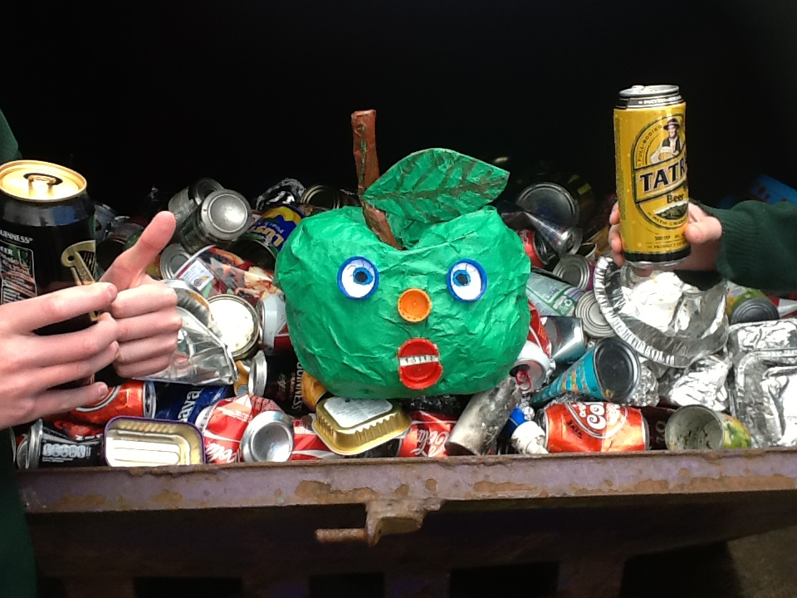
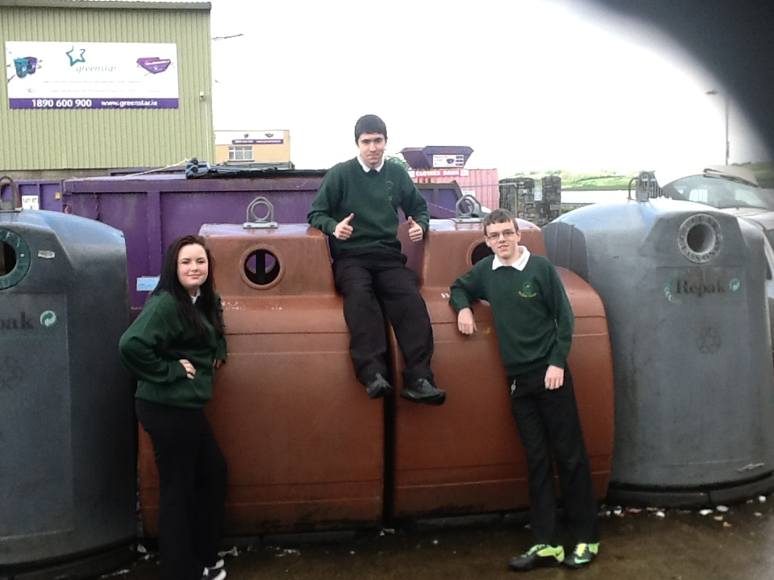
Our trip to the recycling plant

